Slide 1
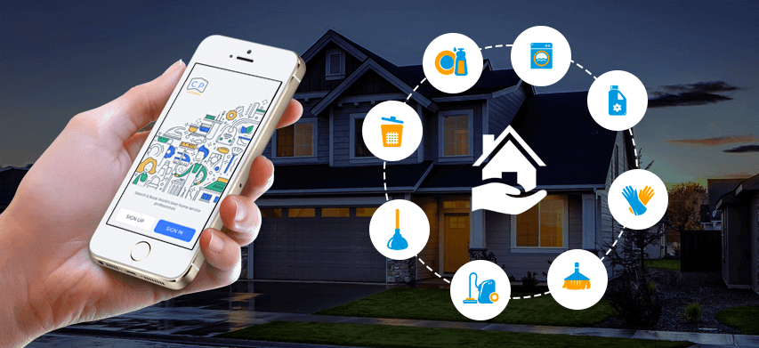
HouseHold Solution
Course No: CSE 3120
Course Name: Software Engineering & Information Systems Laboratory

Slide 2

Introduction
Our app connects you with skilled professionals including electricians, plumbers, carpenters, masons, security guards, maids, WiFi providers, and laborers. Enjoy easy booking, secure payments, and track your service history seamlessly. Provide feedback after each service to help us ensure the highest quality and satisfaction. HouseHold_Solution makes home maintenance and improvement simple and hassle-free.

Slide 3





Key Functionalities
Services
Electrician, Plumber, Carpenter, Mason
Security Guard, Maid, WiFi Provider, Laborer
Booking
Easy booking with time and address
Secure payment options
History
Track previous bookings
View detailed records with dates, provider details, and costs
Feedback
Provide service feedback for quality improvement
Share your experience to help others make informed choices

Slide 4
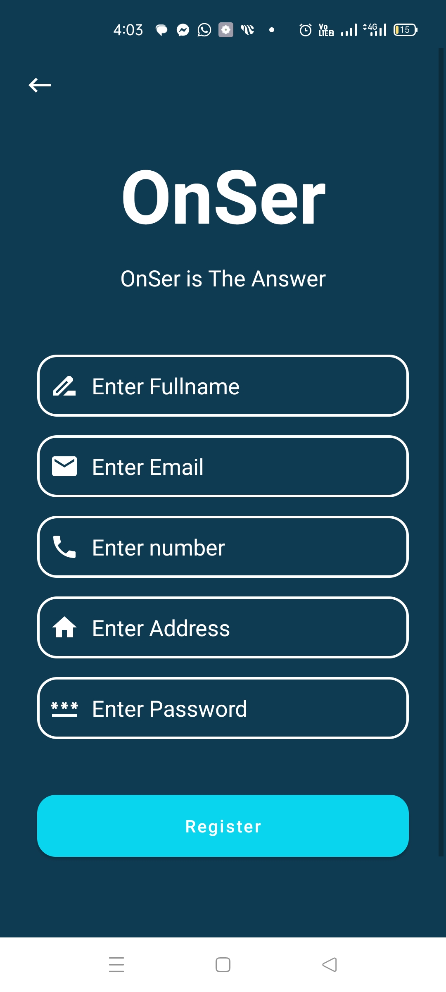
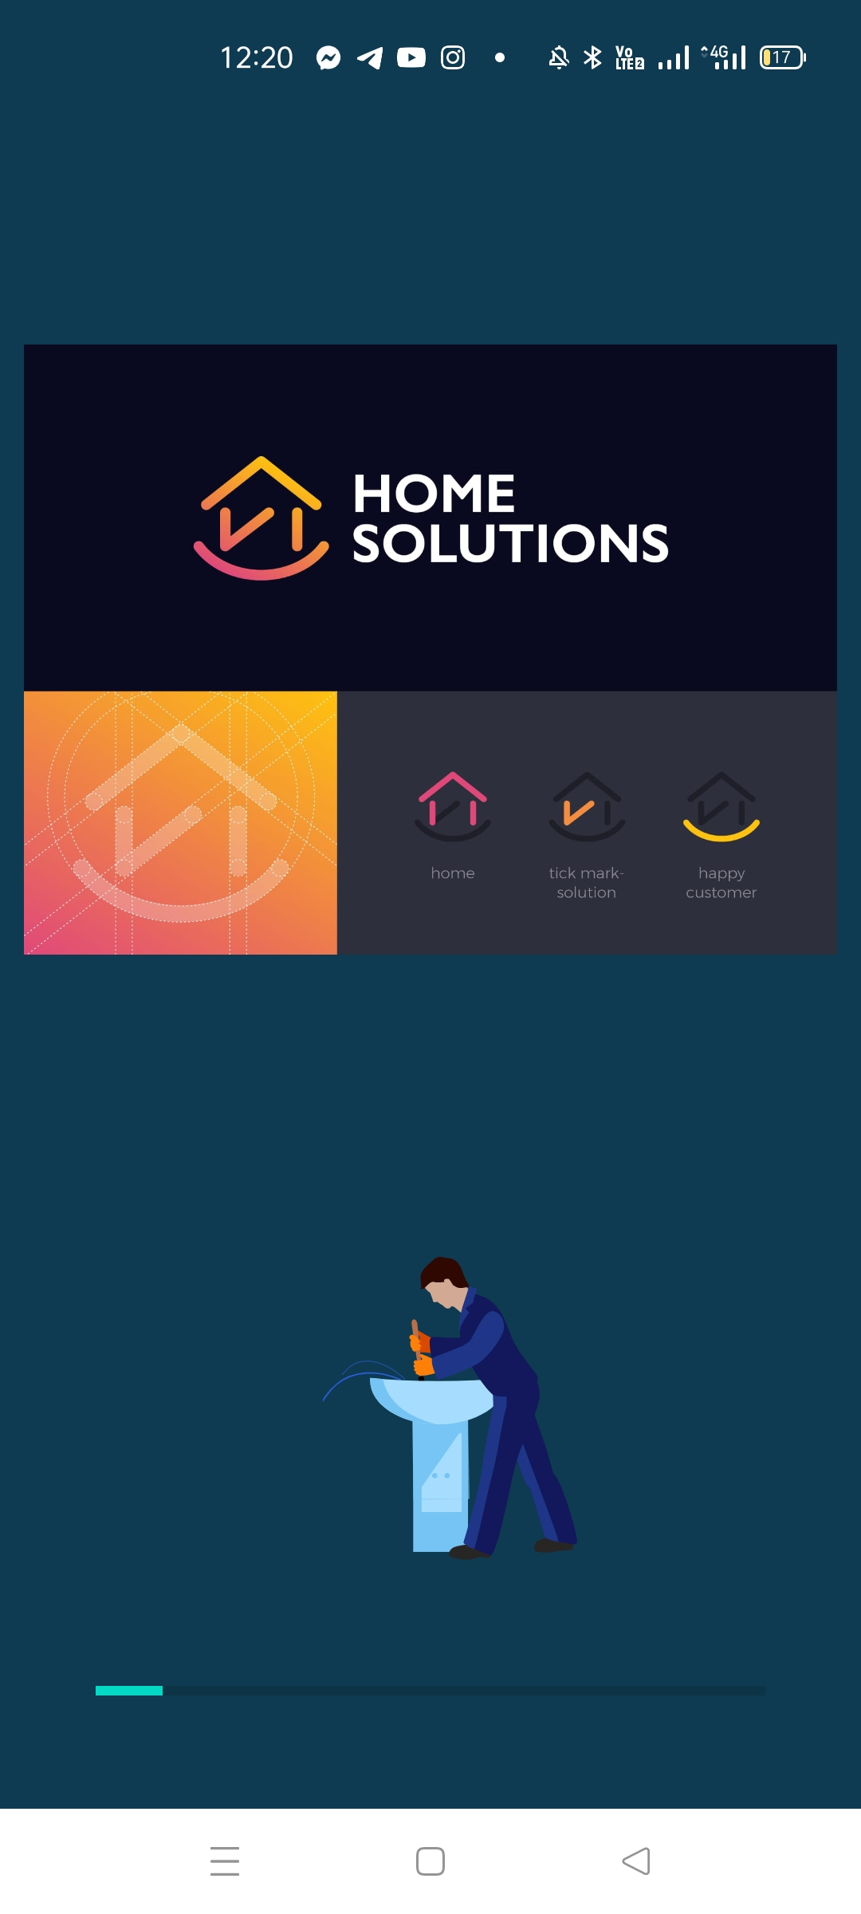
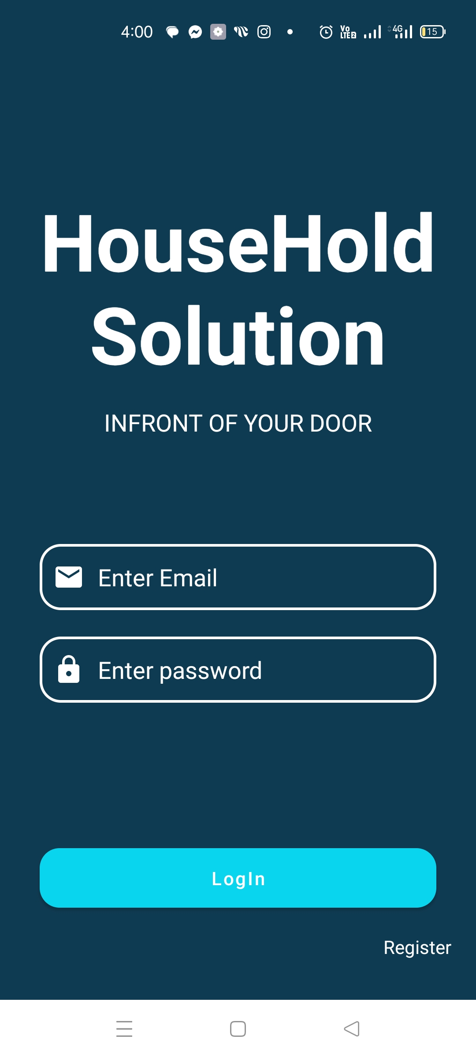
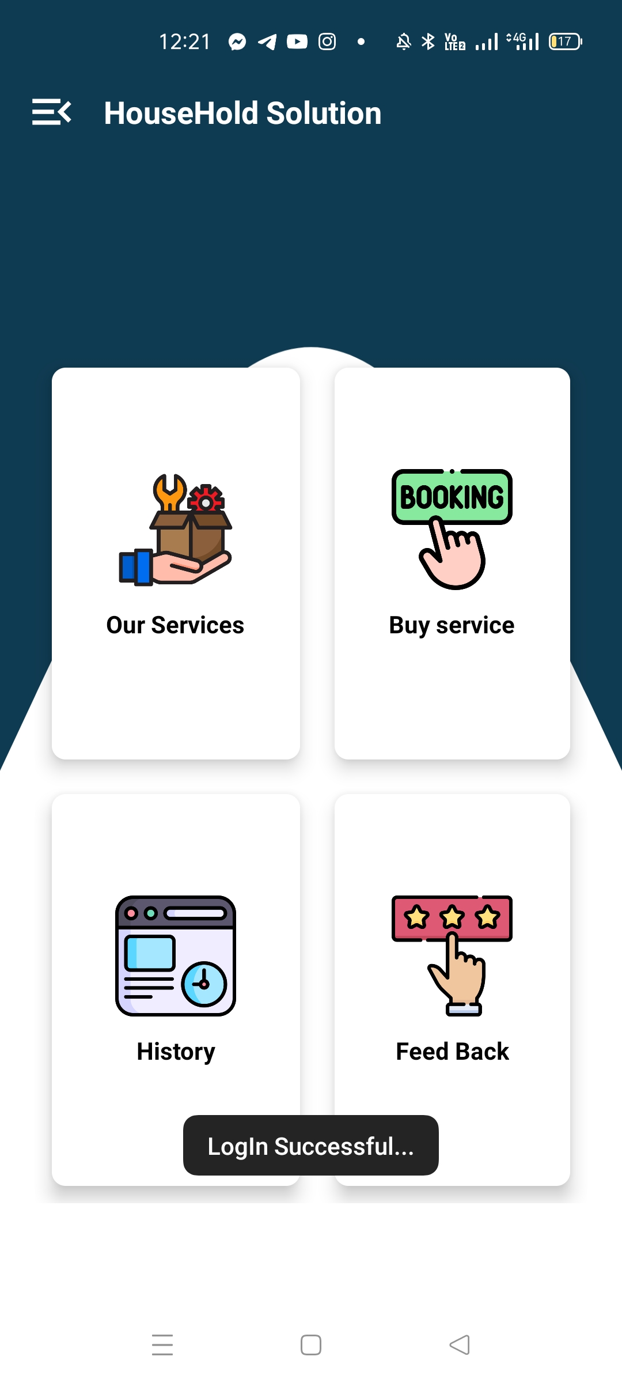
App Preview:

Slide 5
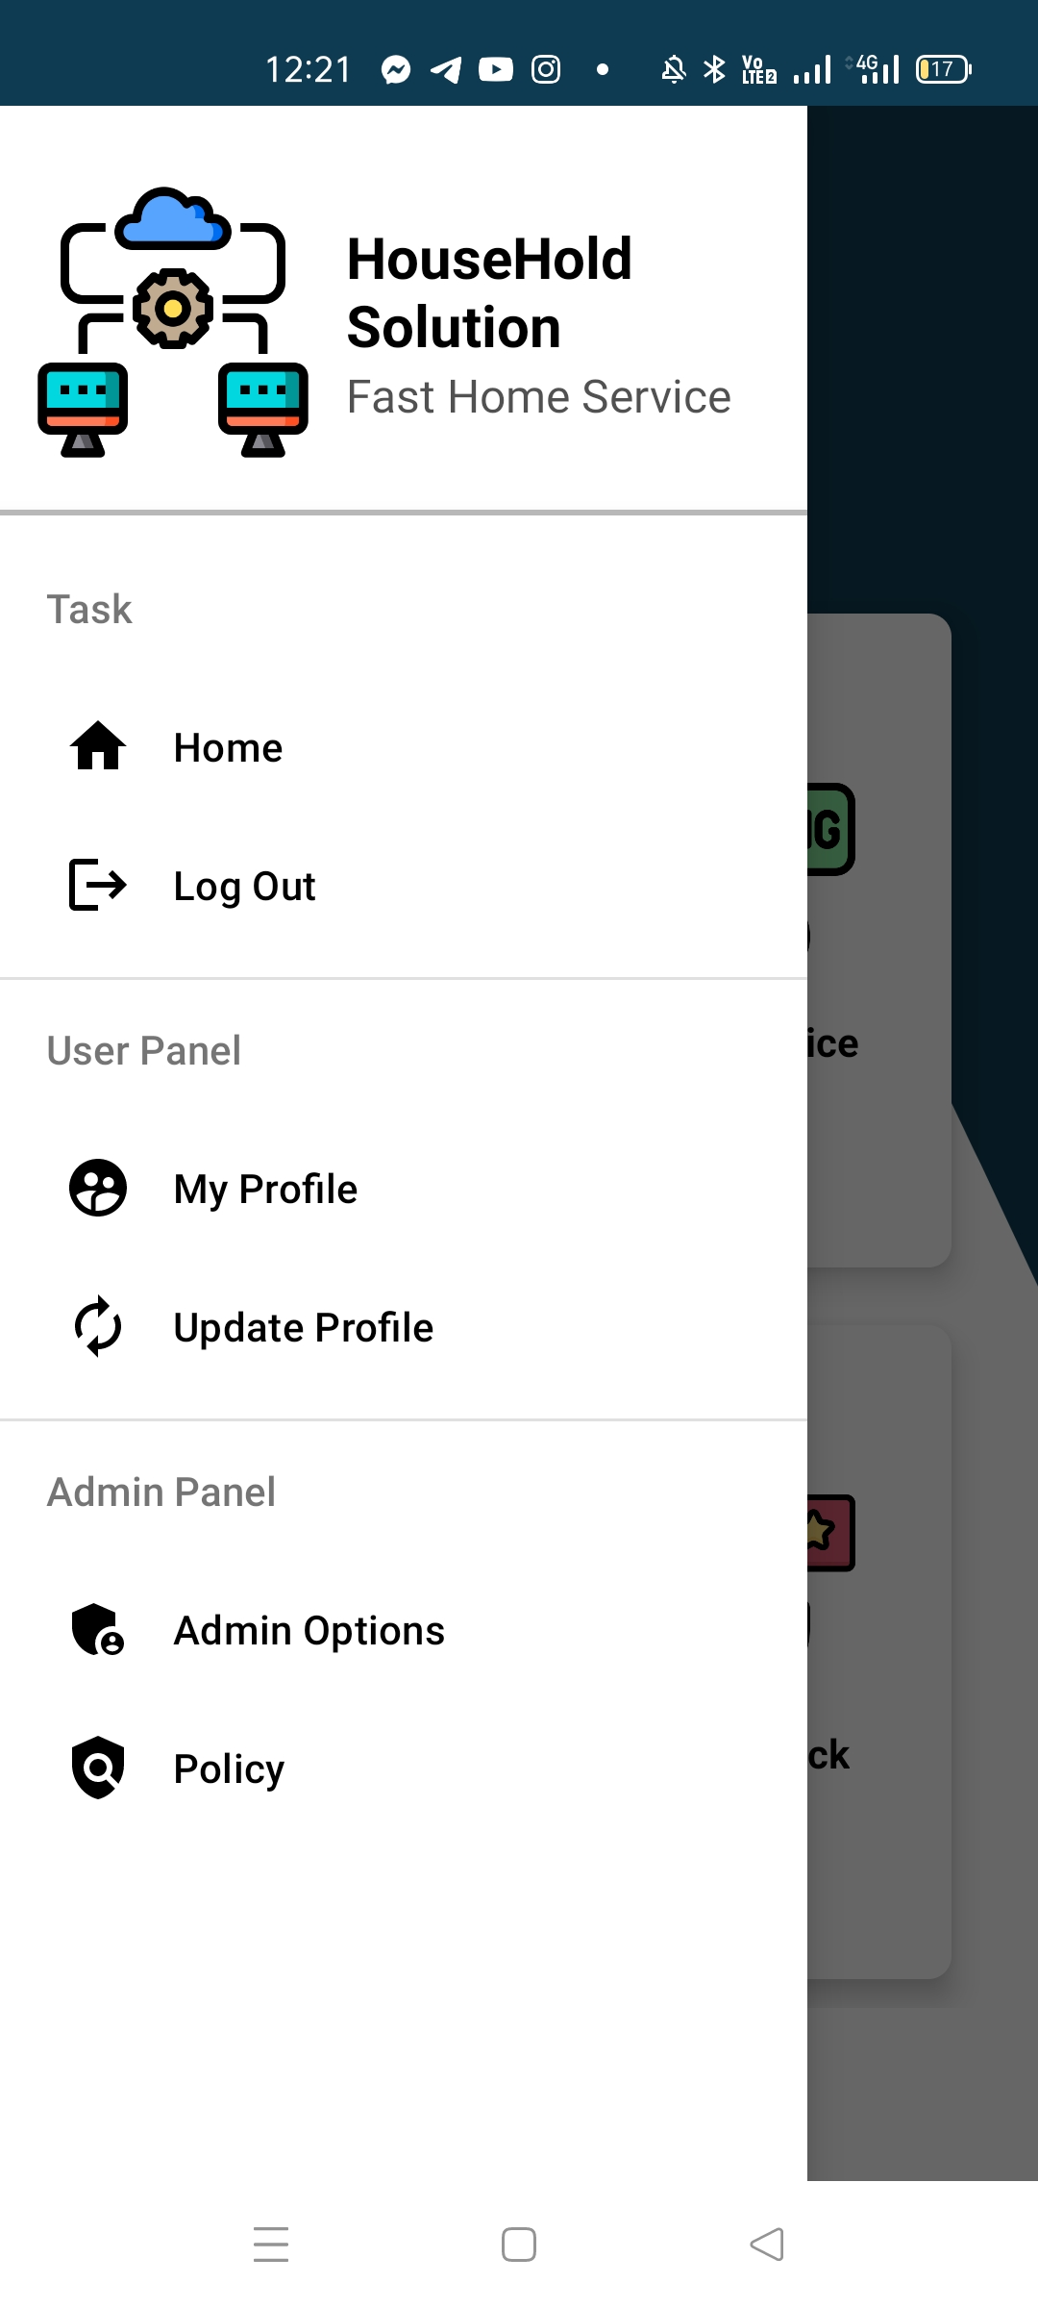
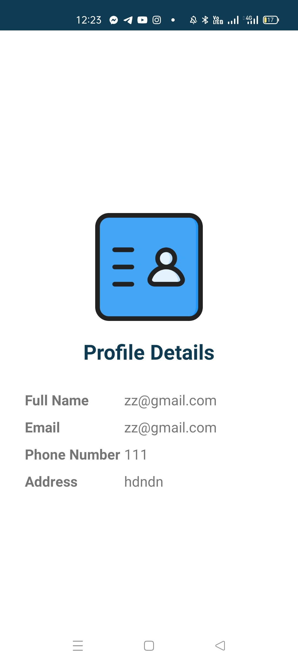
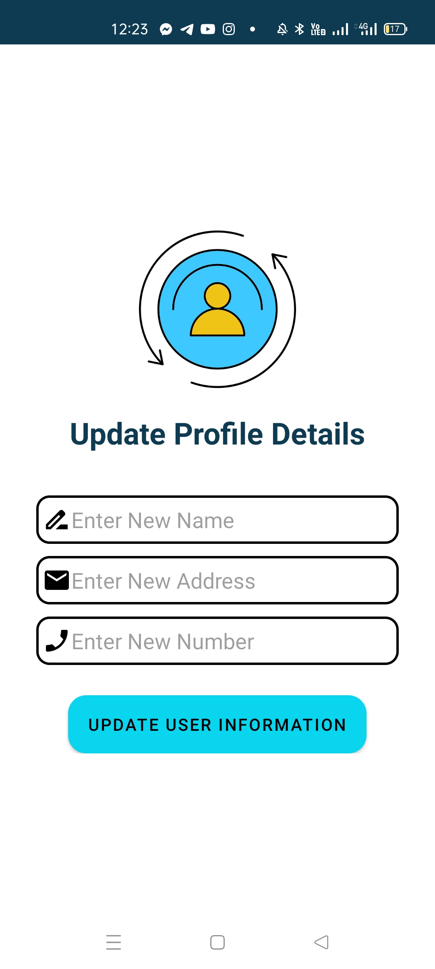
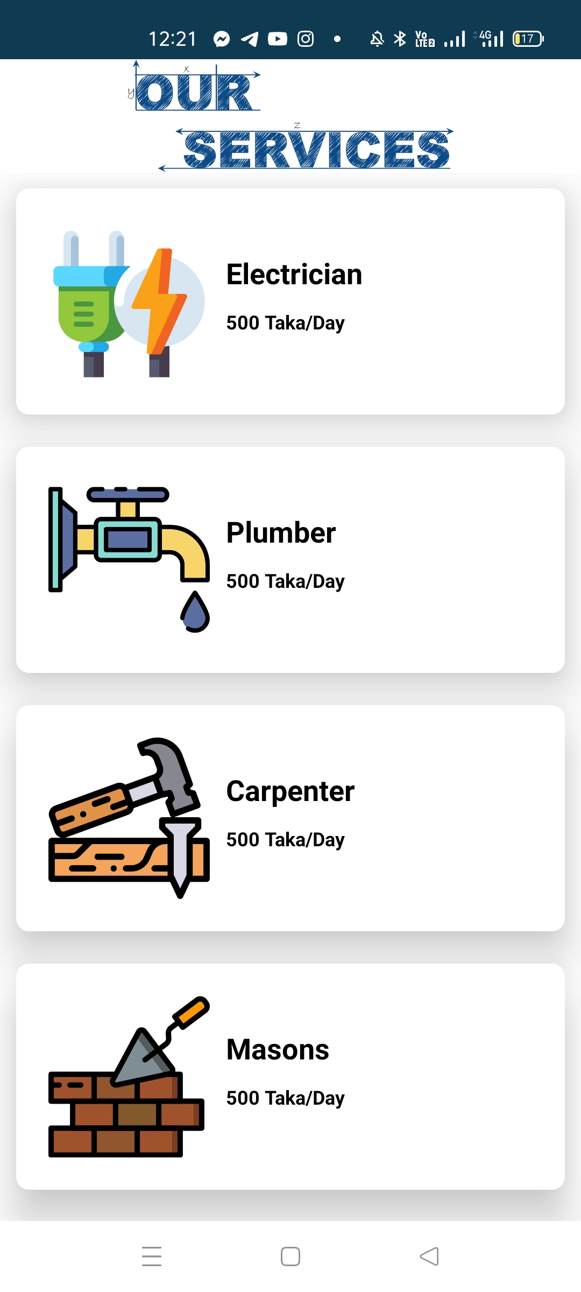
App Preview:

Slide 6
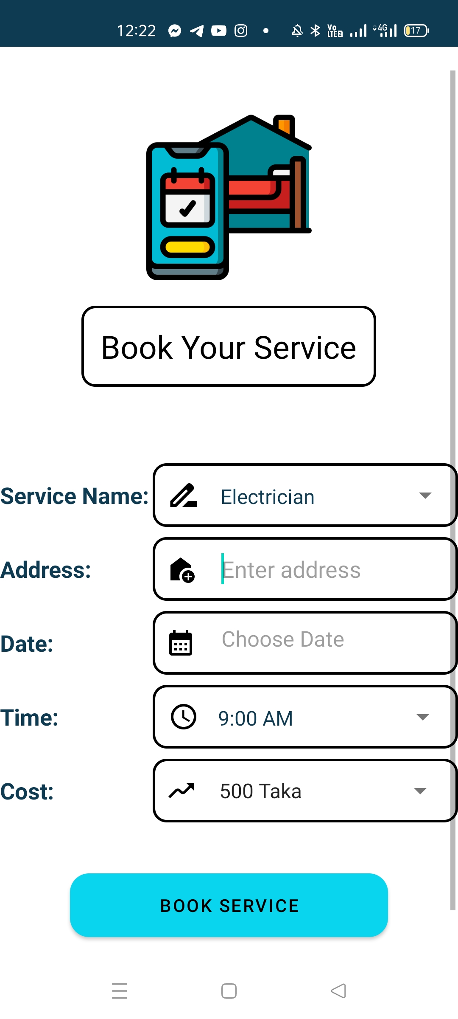
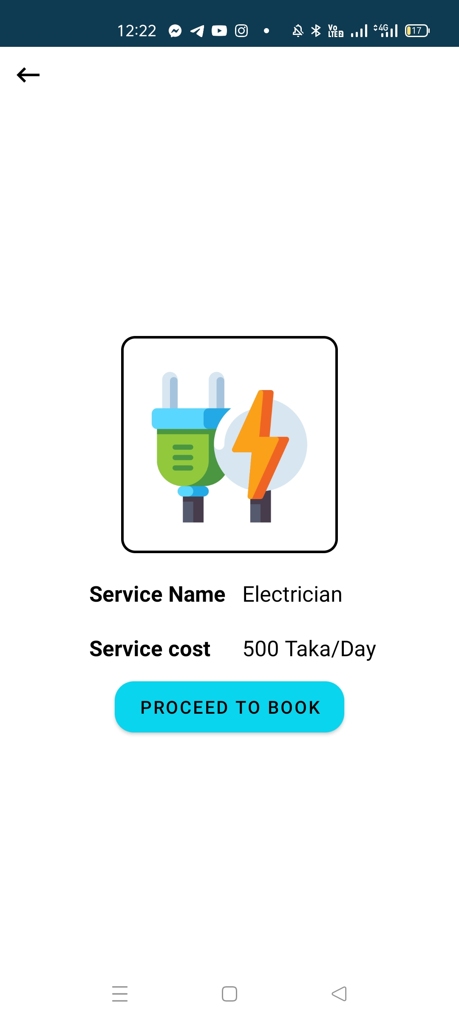
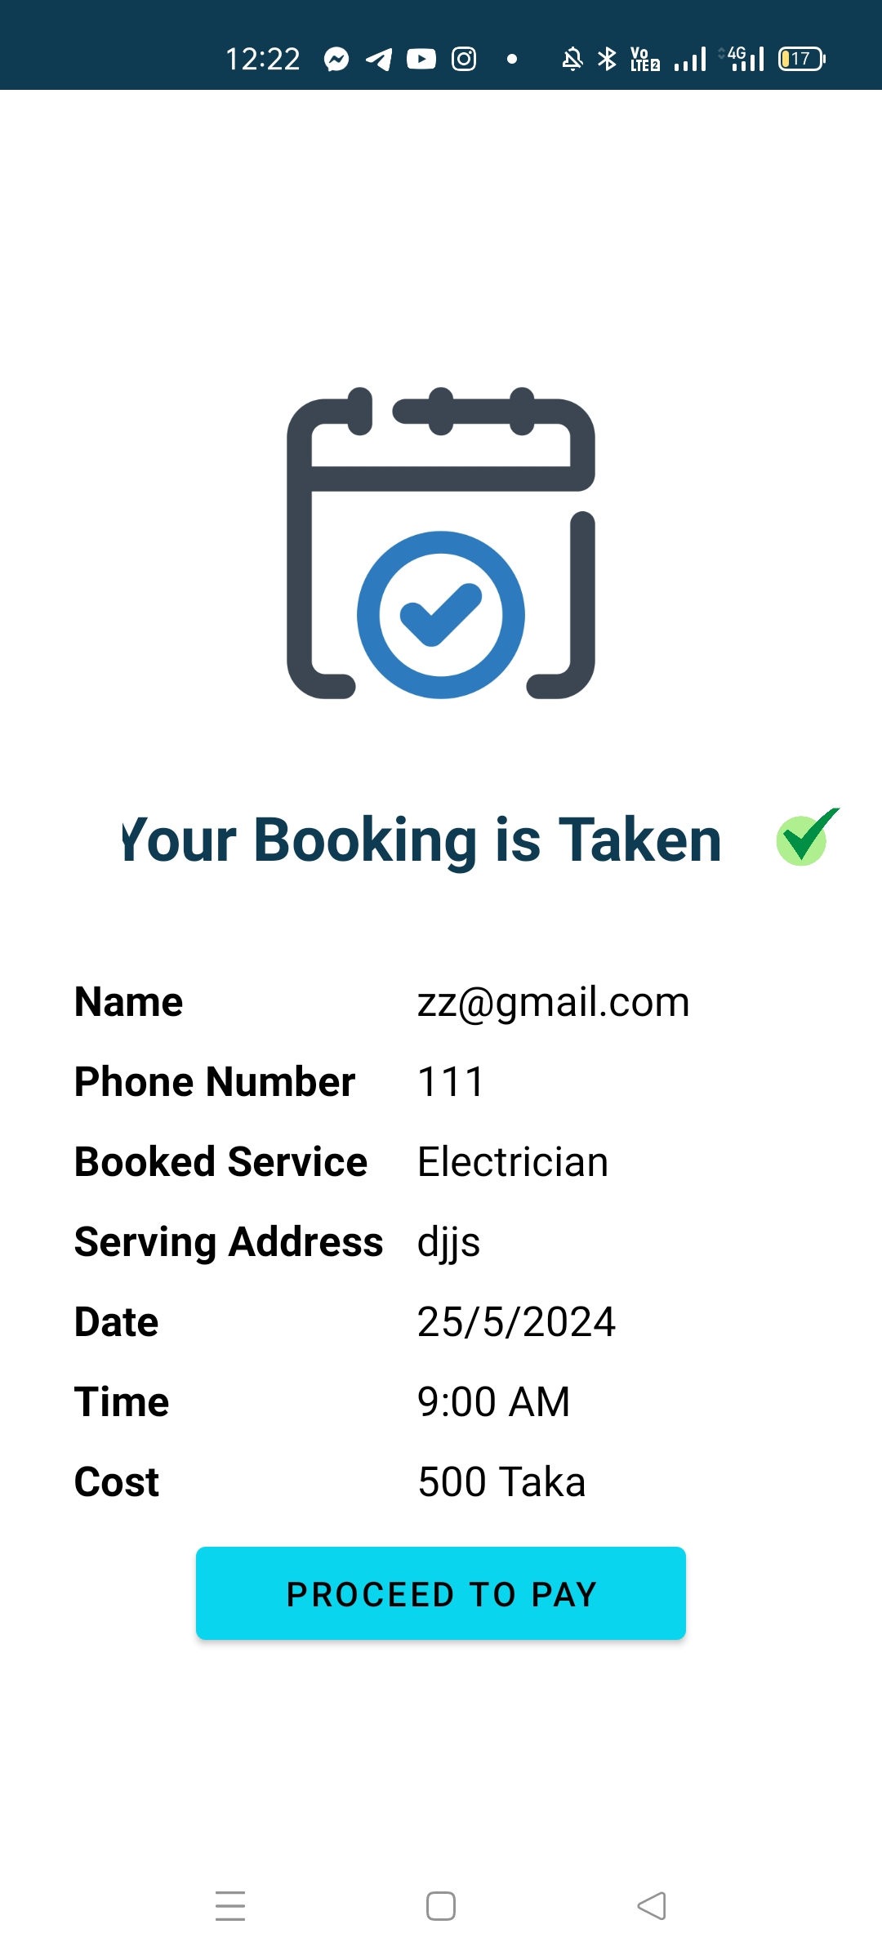
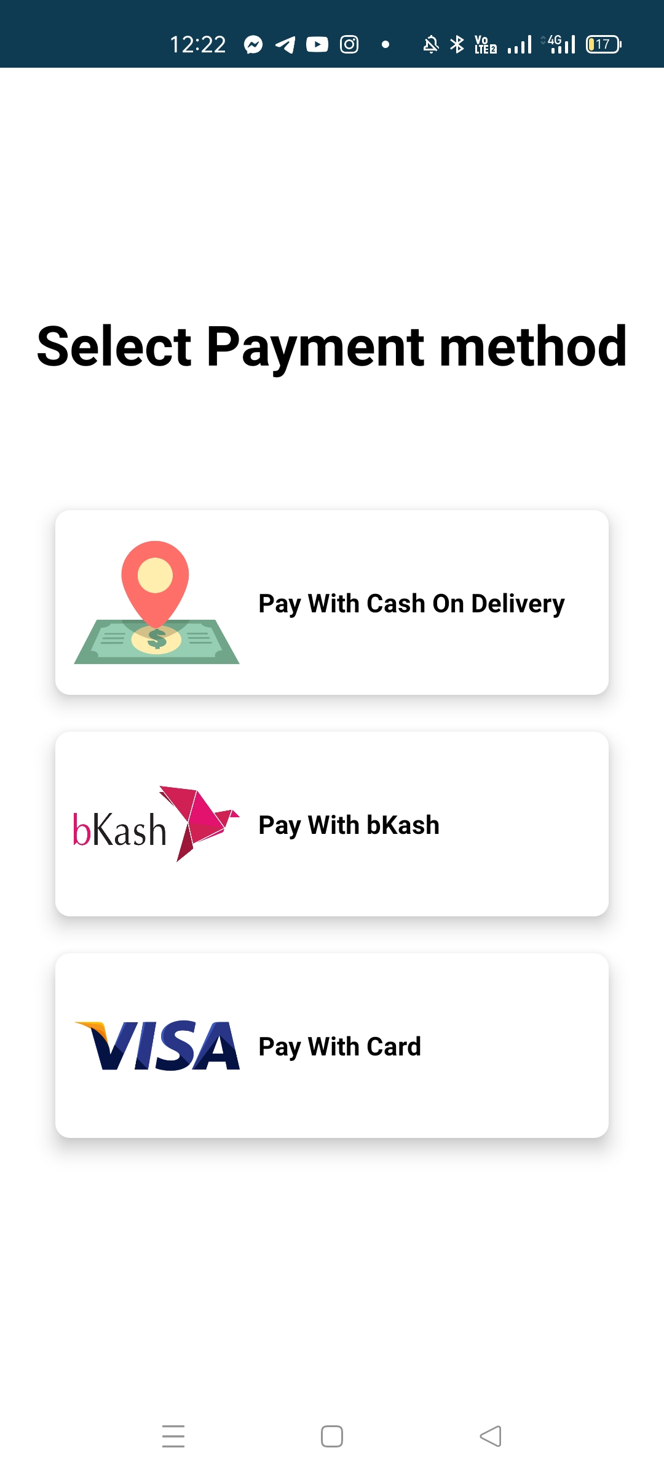
App Preview:

Slide 7
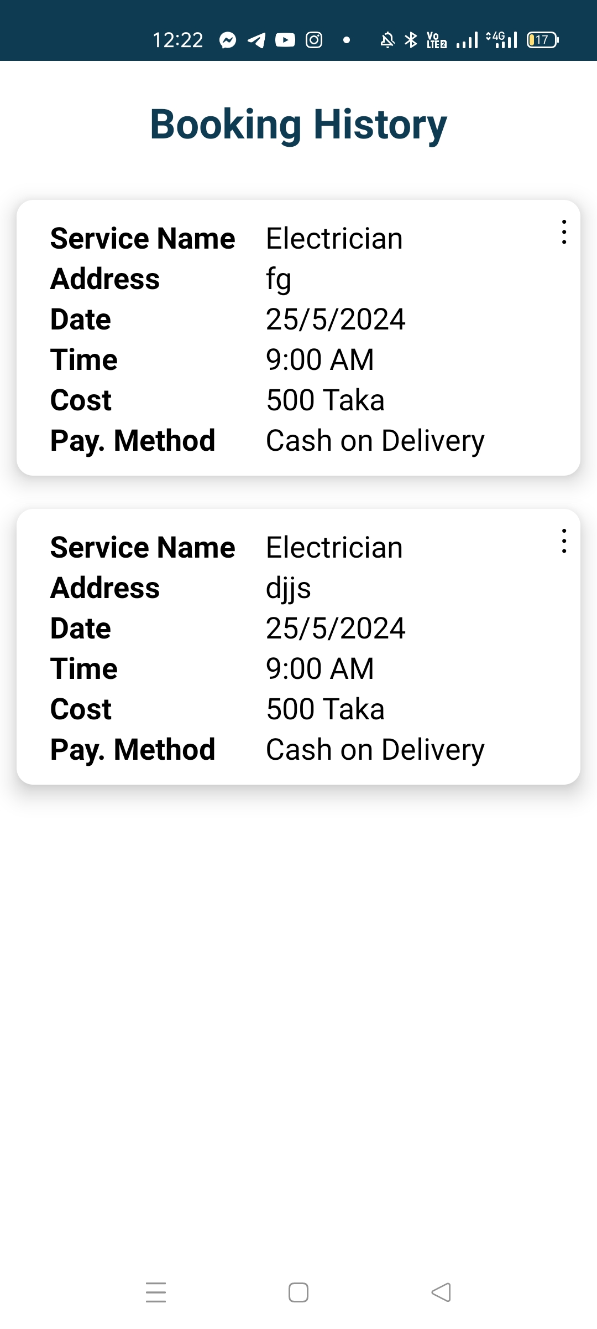
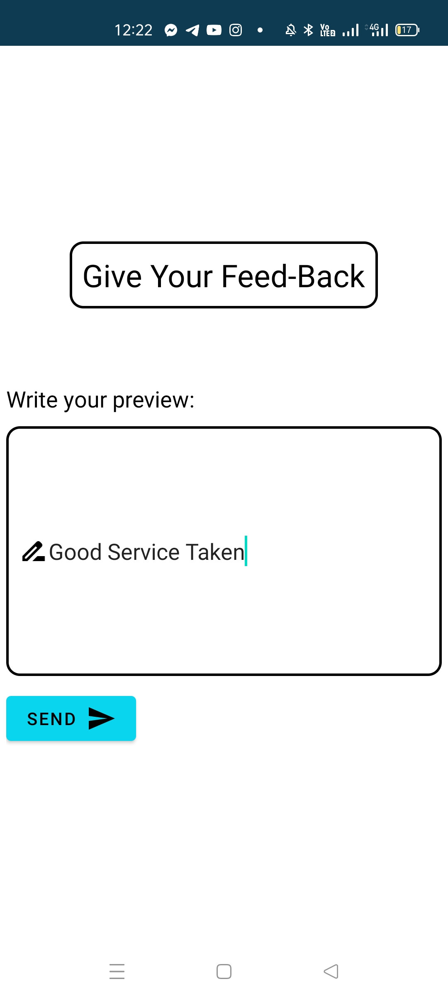
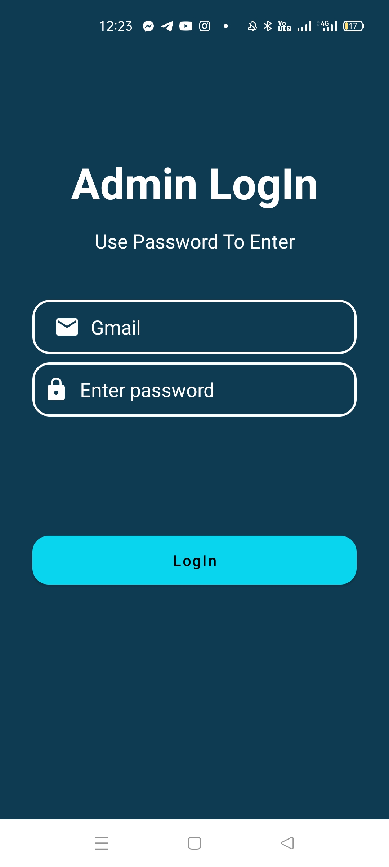
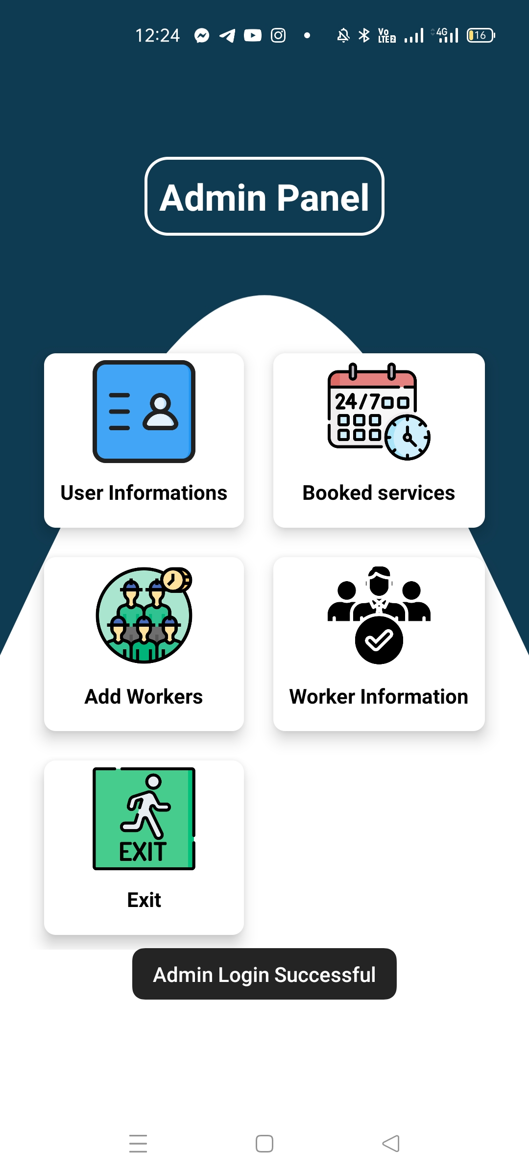
App Preview:

Slide 8
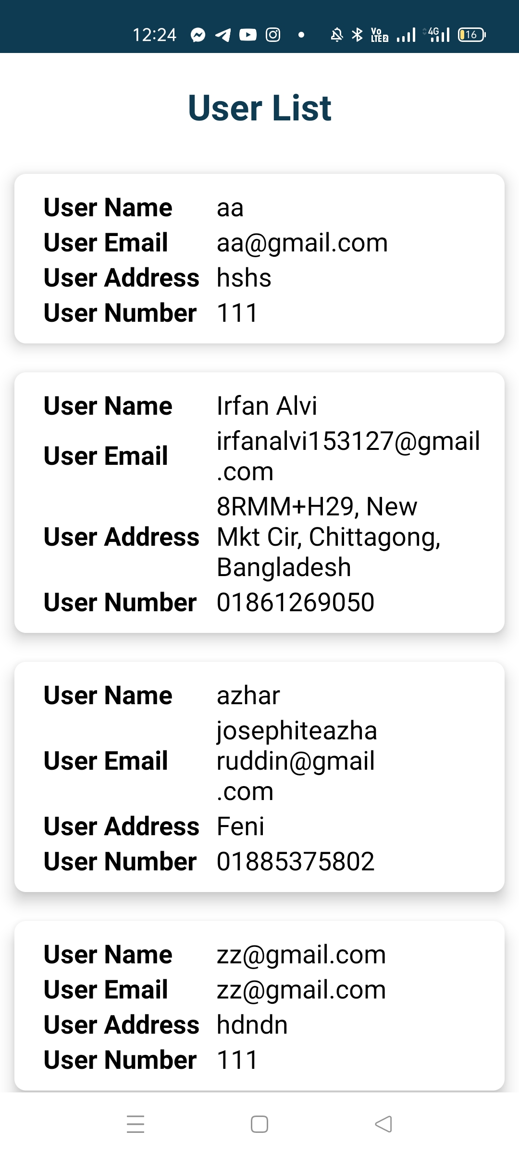
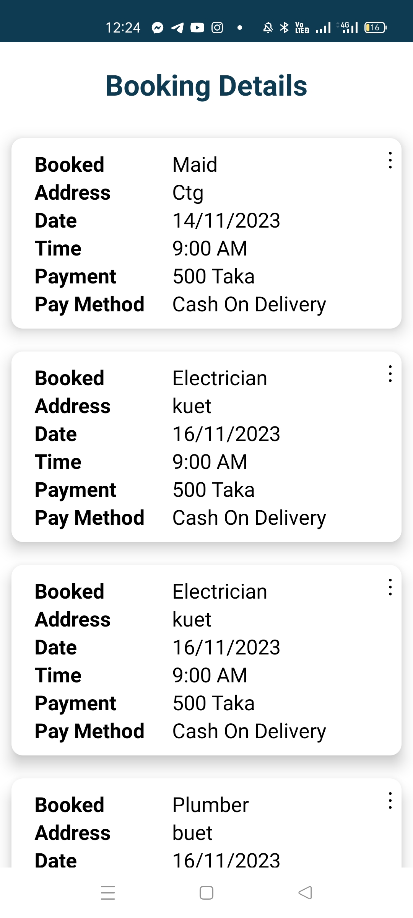
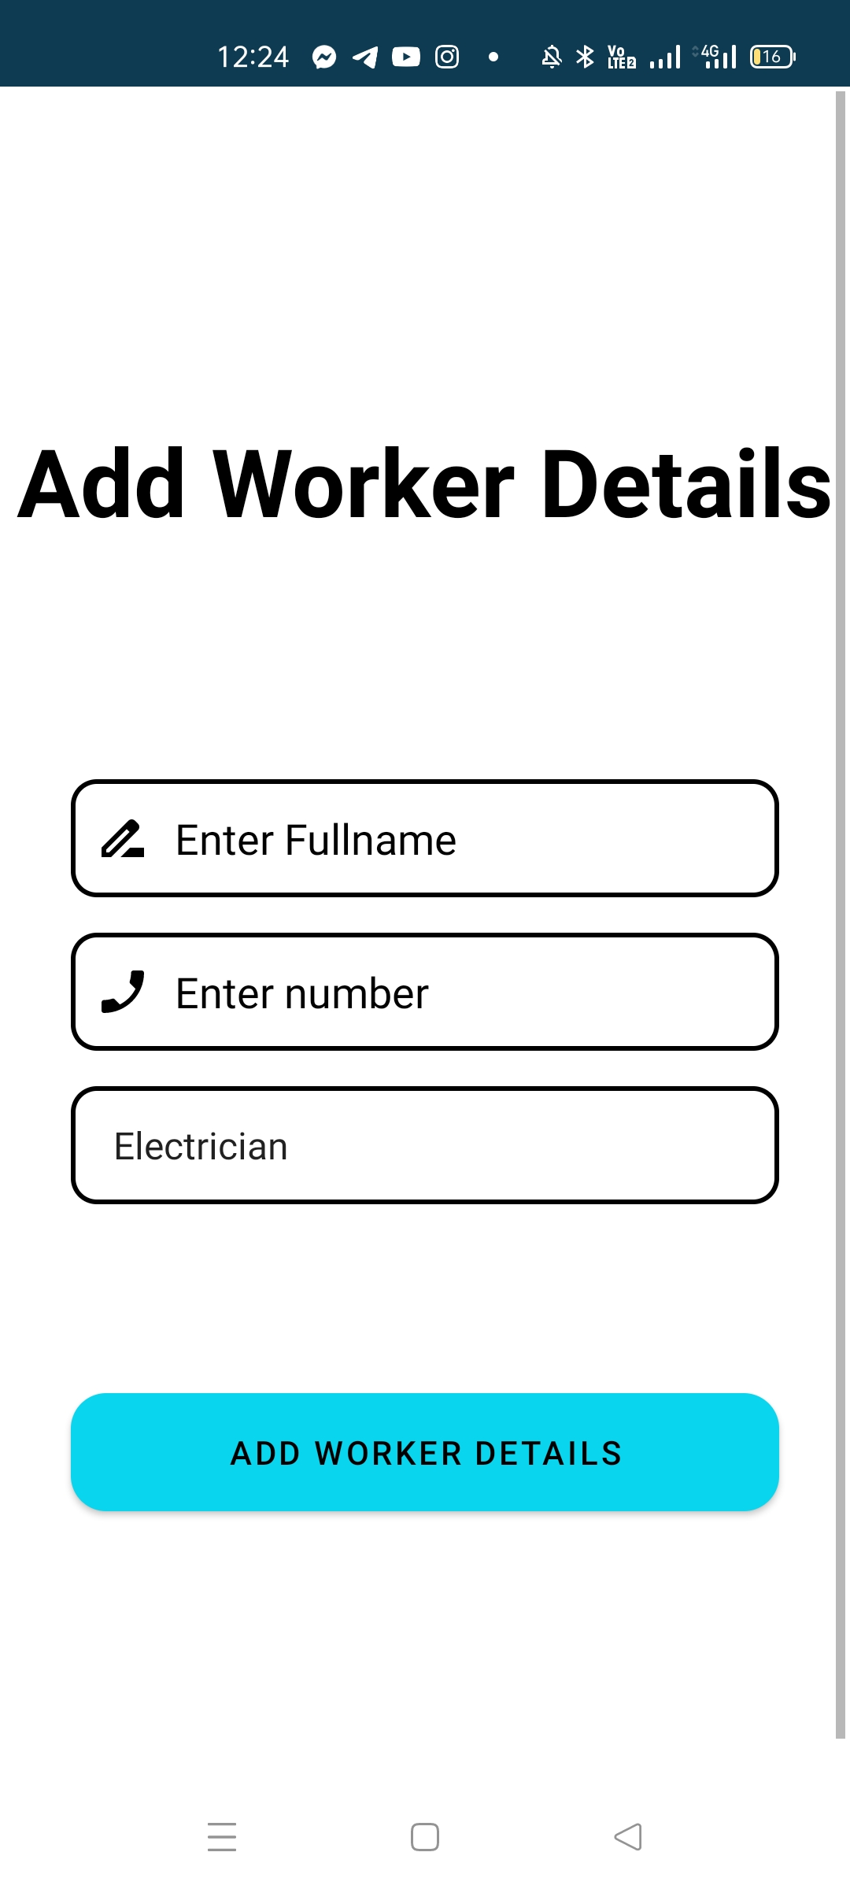
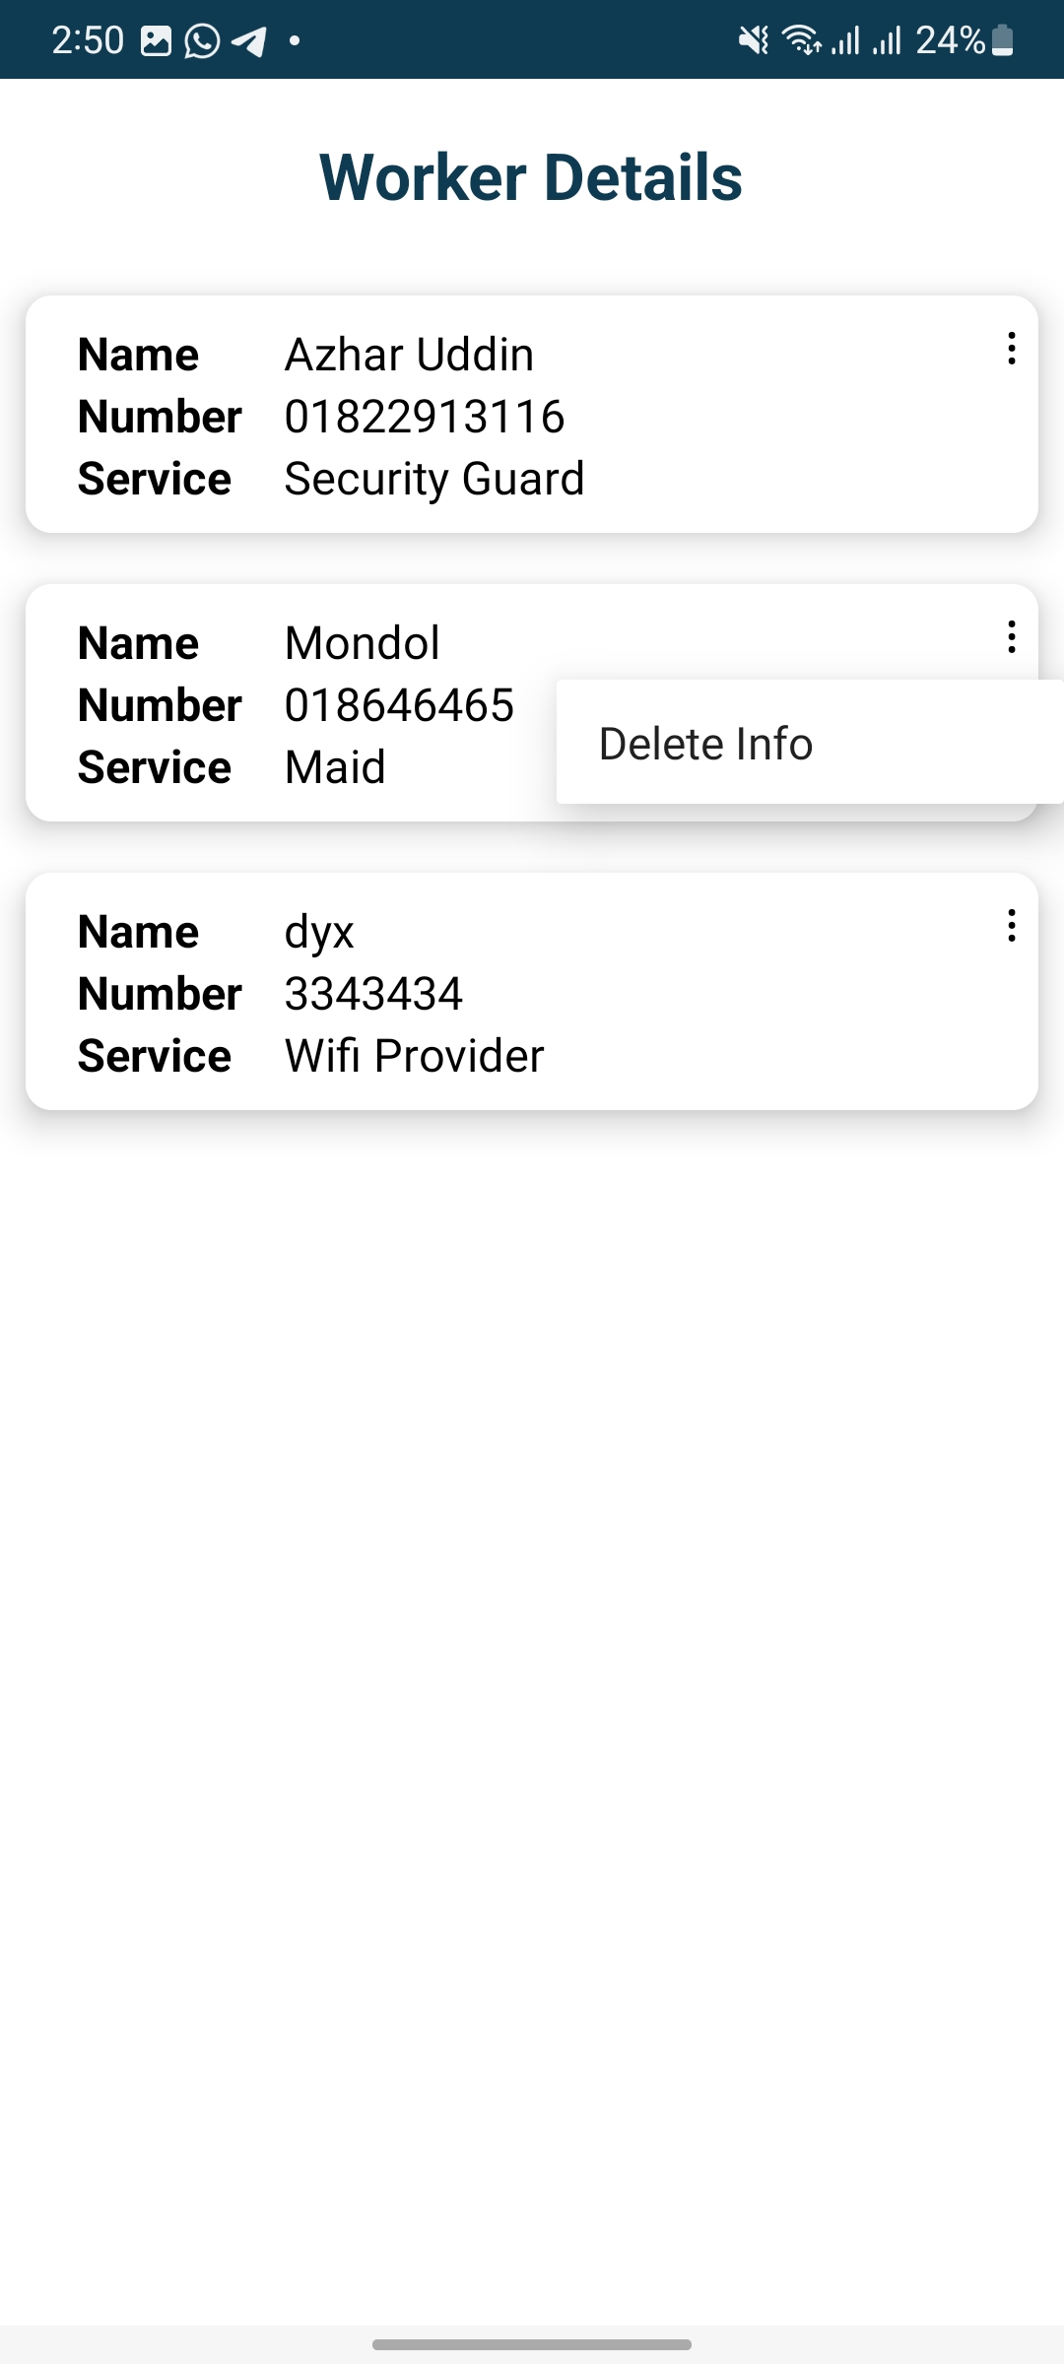
App Preview:

Slide 9
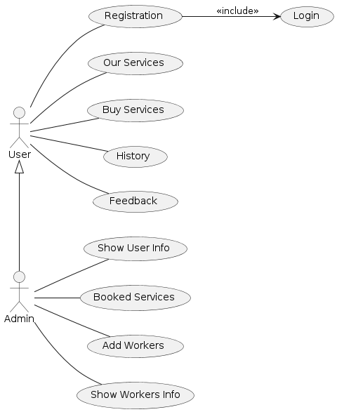
User case diagram of our app

Slide 10

USER FLOW:
Registration and Log in:
Purpose: Enable secure and personalized access to the app's functionalities.
Registration Process:
User Input: Name, e-mail, number, password, confirm password.
Validation: Ensure all fields are correctly filled.
Completion: Confirmation message; redirect to login.
Login Process:
User Input: Username and password.
Authentication: Verify credentials; prevent unauthorized access.
User Access: Redirect to home page.
A secure and easy registration and login process guarantees personalized access to services.

Slide 11

Our Services:
Purpose: To offer a convenient platform for users to book various home services online.
Provide a variety of skilled services for users' convenience, including electricians, plumbers, carpenters, and masons, as well as security guards, maids, WiFi providers, and laborers.
Ensure all professionals are licensed and insured.
Offer specialized tasks and 24/7 emergency assistance to meet all home and business needs.
The 'Our Services' feature ensures a convenient and secure way for users to book various home services, enhancing their overall home maintenance and management experience.

Slide 12
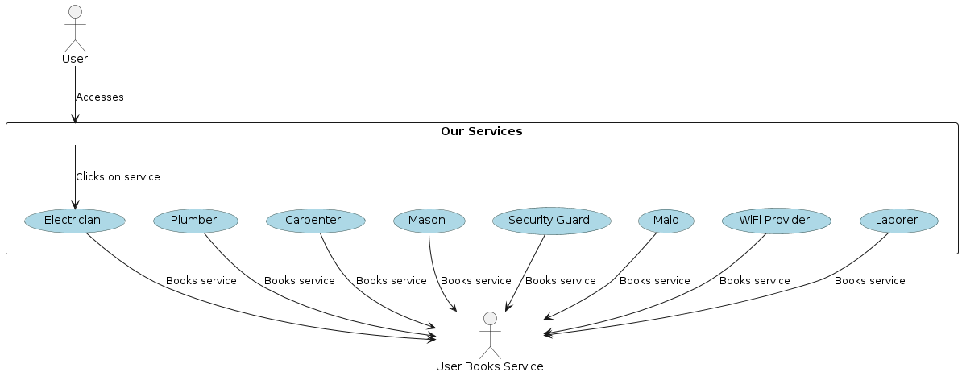
Use case diagram of Our Service Section

Slide 13
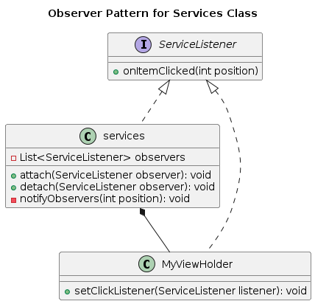
Our Service Section
The observer design pattern is implemented
ServiceListener: Interface defining the observer with the onItemClicked(int position) method.
services: Subject class maintaining a list of observers (ServiceListener) and notifying them of changes.
MyViewHolder: Concrete observer class registering for item click events and notifying the observer (ServiceListener) when an item is clicked.

Slide 14
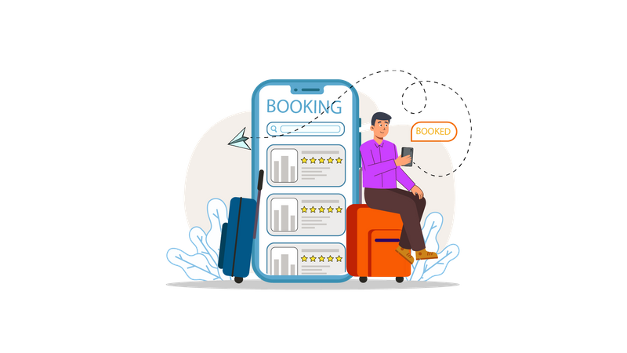
Booking Services
Purpose: Secure a reservation for a desired service, activity, within a specified timeframe.
Selection: Users choose desired services and provide details like date, time, and location.
Validation: System validates service details for availability and correctness.
Confirmation: Users receive confirmation of their requested services
Payment: Users select a payment method and complete the transaction.
Processing: System handles payment securely using chosen method.
Confirmation: Users receive booking confirmation with details.
Management: System updates records and manages bookings efficiently.

Slide 15
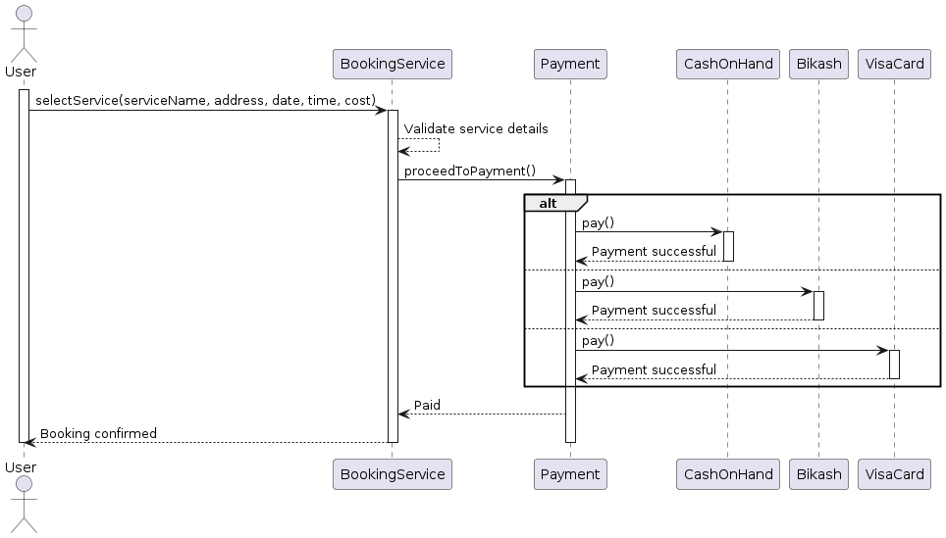
Sequence Diagram Of Booking services

Slide 16
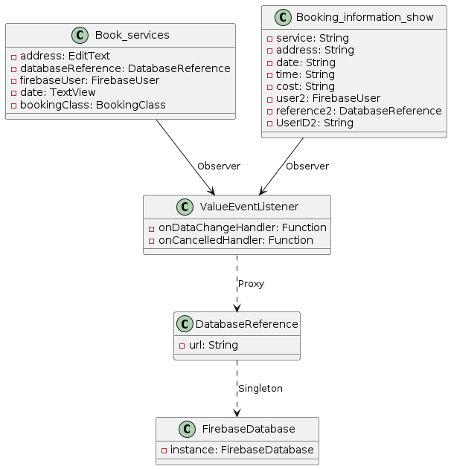
Design Pattern Implemented in Booking Services
Observer Pattern is used, as ValueEventListener acts as an observer that listens for changes in the database (DatabaseReference). Both Booking_information_show and Book_services are observers subscribing to changes in the database.
Singleton Pattern is used for FirebaseDatabase, ensuring there is only one instance of the database throughout the application.
Proxy Pattern is represented by the relationship between ValueEventListener and DatabaseReference, where ValueEventListener acts as a proxy to the actual database reference, providing a level of indirection and control over access to the database.

Slide 17
History Section
Overview of the user's booking history
Detailed record of past reservations
Convenient reference point for tracking previous bookings
Includes dates, locations, and relevant details
Enables efficient management of past activities
Facilitates making future plans
Ensures a seamless booking experience

Slide 18
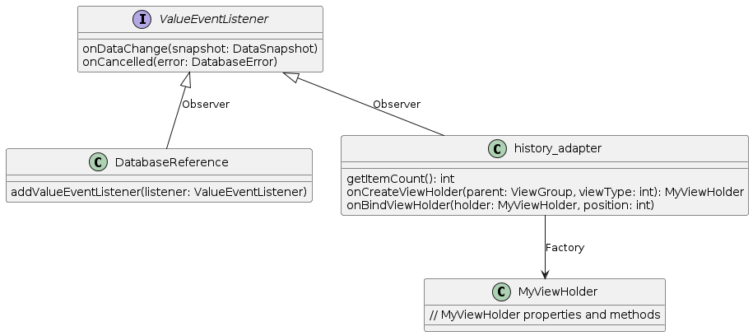
Design pattern implemented in History Section

Slide 19
Feedback Section
Valuable feedback from users regarding their booking experience
Comments, suggestions, and ratings provided by users
Insights into satisfaction levels and areas for improvement
Crucial for enhancing the booking platform
Ensures a positive user experience

Slide 20

Admin Section
Admins have access to vital functionalities including:
User Information: Admins can view comprehensive details about users registered on the platform, facilitating effective communication and assistance.
Booked Services of Users: Admins can monitor and manage the services booked by users, ensuring smooth operations and resolving any issues promptly.
Add Worker: Admins have the authority to add new workers to the system, enabling workforce expansion and efficient allocation of resources.
Worker Information: Admins can access and review pertinent information about workers, such as contact details and service expertise, streamlining coordination and optimizing service delivery.

Slide 21
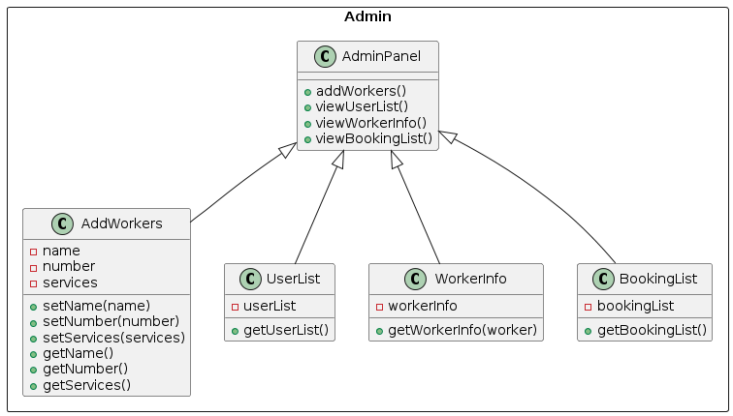
Class Diagram of the Admin Panel

Slide 22

Add Worker Section
Admins can input the worker's name.
Admins can input the worker's contact number.
Admins can specify the service the worker will provide
Ensures full control over the addition process.
Maintains the integrity and accuracy of the worker database.

Slide 23
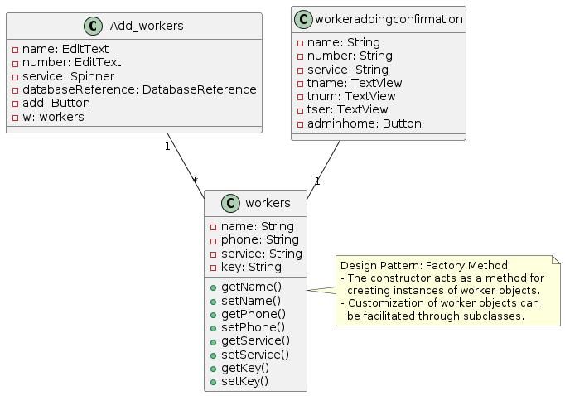
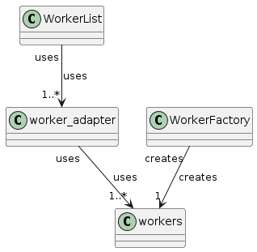
Design Patten Applied in Add Worker Section

Slide 24

Booking Details Overview
Service Booked: Specifies the type of service that has been booked by the user.
Location: Indicates where the service is booked, providing crucial information for logistics and resource allocation.
Date and Time: Displays the date and time slot selected for the service booking, aiding in scheduling and coordination.
Amount: Reflects the cost associated with the booked service, assisting in financial tracking and analysis.
Payment Method: Specifies the method used for payment, whether it's credit/debit card, cash, or any other payment option available.

Slide 25
Design Pattern Implemented in Showing Booking Details
Observer Pattern is used, as ValueEventListener acts as an observer that listens for changes in the database (DatabaseReference). Both Booking_information_show and Book_services are observers subscribing to changes in the database.
Singleton Pattern is used for FirebaseDatabase, ensuring there is only one instance of the database throughout the application.
Proxy Pattern is represented by the relationship between ValueEventListener and DatabaseReference, where ValueEventListener acts as a proxy to the actual database reference, providing a level of indirection and control over access to the database.

Slide 26
User’s Information
User Name: The name by which the user is identified.
Email: The electronic mail address associated with the user's account.
Address: The physical location where the user resides or conducts business.
Number: This could refer to a phone number or any other numerical identifier linked to the user's account.

Slide 27
Worker’s Details
User Name: The name by which the worker is identified within the system.
Number: A unique identifier associated with the worker, such as a phone number or employee ID.
Service: Describes the type of service or job role the worker performs.
Additionally, the admin has the authority to delete a worker's information from the worker details, presumably removing them from the system or database.

Slide 28
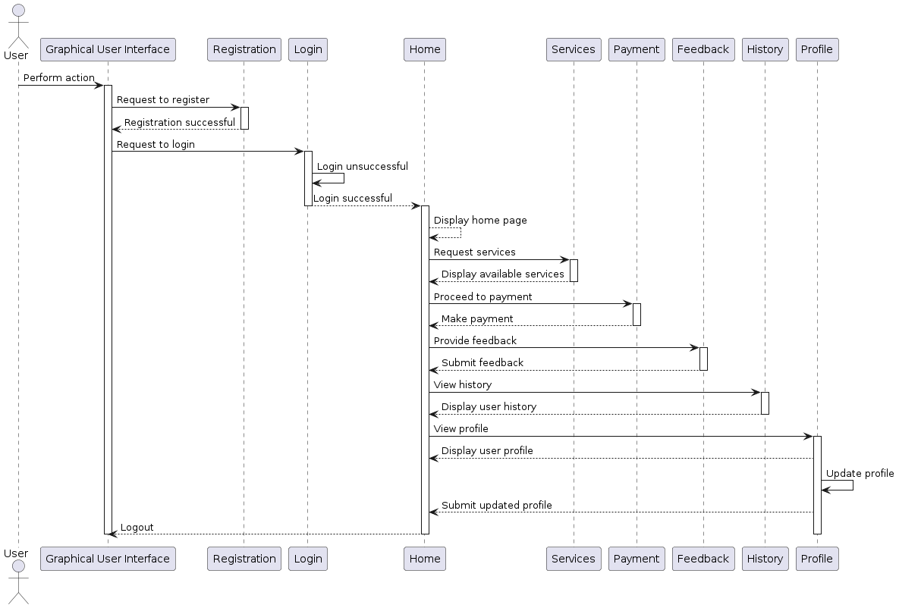
App Overwiew
Users can register for a new account.
Users can log into the system with their credentials.
The system displays the home page after a successful login.
Users can browse and request available services.
The system facilitates secure payment processing for services.
Users can submit feedback on the services they used.
The system provides access to the user's service history.
Users can view their personal profile information.
Users can update their profile information.
The system allows users to log out securely.

Slide 29
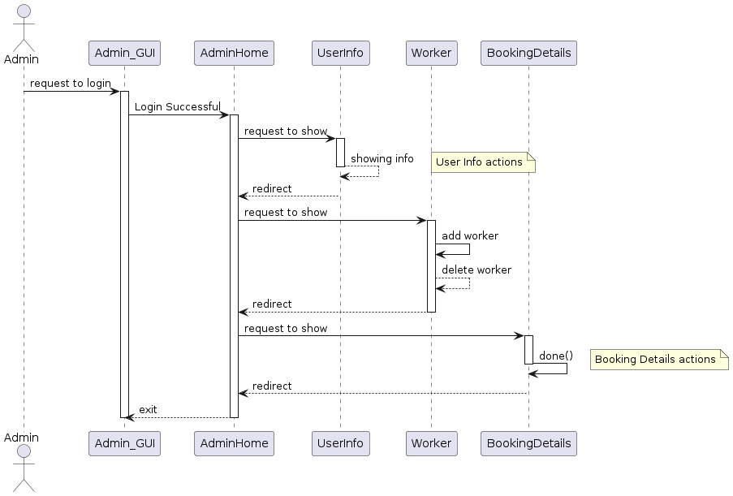
Admin Section Overview of the App
Admin logs into the system.
Successful login directs admin to the Admin Home page.
Admin requests to view user information.
System displays the requested user information.
Admin returns to the Admin Home page.
Admin requests to manage workers.
System displays the worker management page.
Admin adds a new worker.
Admin deletes an existing worker.
Admin requests to view and manage booking details.

Slide 30

Testing
Unit Test
UI Test
Integration Test
Continuous Integration
Javadoc

Slide 31



Presented By
Tirtho Mondal
Roll: 2007117
Marufa Akter Meem
Roll: 2007105
Azhar Uddin
Roll: 2007112

